Slide 1

Water Level Indicator Project
A Simple Electronics Project for Liquid Level Monitoring

Slide 2
Introduction
The Water Level Indicator is a project designed to monitor and indicate the
water level in a tank without using Arduino. This project uses simple electronic
components like transistors, LEDs, and resistors to show water levels at different
stages.

Slide 3
Objectives
- Monitor water level in overhead tanks or reservoirs.
- Prevent overflow and dry running of pumps.
- Save electricity and water resources.
- Provide a cost-effective and easy-to-build solution.

Slide 4
Working Principle
The system works on the conductivity of water. As water rises, it completes
circuits through probes placed at different heights. This triggers transistors,
lighting up corresponding LEDs to indicate the water level.

Slide 5
Components Required
- 3 to 5 NPN Transistors (e.g., BC547)
- 3 to 5 LEDs (Red, Yellow, Green)
- Resistors (220Ω to 1KΩ)
- Water Level Probes (Wires)
- Power Supply (5V to 9V)
- Breadboard and Connecting Wires

Slide 6
Circuit Diagram
The circuit consists of probes placed at different water levels. Each probe I
s connected to the base of a transistor through a resistor. When water touches a
probe, the transistor conducts, lighting up an LED.

Slide 7
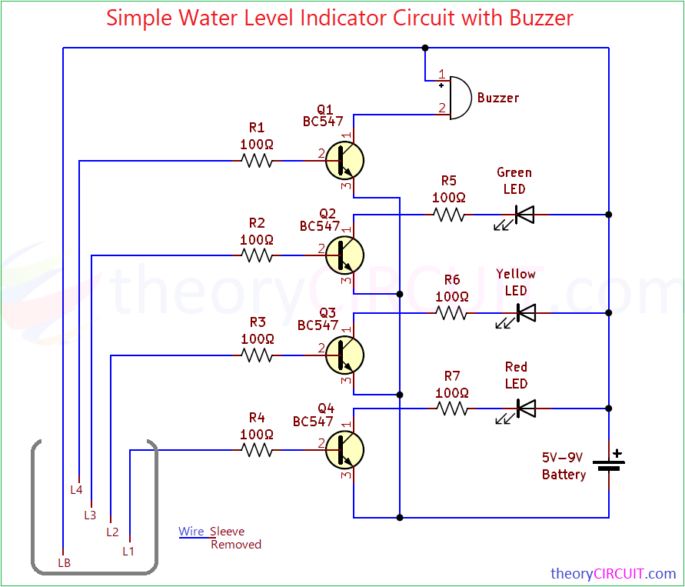
Circuit Diagram

Slide 8
Working Explanation
- Water rises and touches the first probe, turning on the red LED.
- As the water level increases, more probes get activated, lighting up yellow
and green LEDs.
- When the tank is full, all LEDs light up, indicating the need to stop the pump.

Slide 9
Advantages and Applications
- **Advantages:** Simple, low-cost, energy-efficient, and reliable.
- **Applications:** Overhead water tanks, sumps, industrial water storage,
and agricultural water management.

Slide 10
Applications
🌿 Domestic Applications:
Overhead Water Tanks:
Monitors the water level in household tanks and prevents overflow or dry running.
Alerts when the tank is full or empty, saving water and electricity.
Sumps and Underground Tanks:
Indicates when the sump is full or empty, helping to manage water pumping efficiently.

Slide 11
Applications
🏭 Industrial Applications:
Industrial Water Storage:
Used in factories and industries to monitor water levels in storage tanks and cooling towers.
Chemical Plants:
Ensures safe water levels in chemical processing units to avoid overflow or spillage.

Slide 12
Applications
🚜 Agricultural Applications:
Irrigation Systems:
Helps farmers monitor water levels in storage tanks used for irrigation.
Borewell Monitoring:
Indicates the water level in borewells to prevent dry running of pumps.

Slide 13
Applications
🏥 Commercial and Institutional Use:
Hospitals and Schools:
Ensures uninterrupted water supply by monitoring storage tank levels.
Hotels and Apartments:
Prevents wastage and ensures optimal water management.

Slide 14
Applications
🌊 Environmental Applications:
Rainwater Harvesting:
Monitors the water level in rainwater collection tanks.
Flood Monitoring:
Can be adapted to detect rising water levels in flood-prone areas.

Slide 15
Conclusion
The Water Level Indicator project provides an efficient and
economical solution to monitor water levels without using microcontrollers
like Arduino. It ensures optimal water usage and prevents overflow or dry
running of pumps.

Slide 16
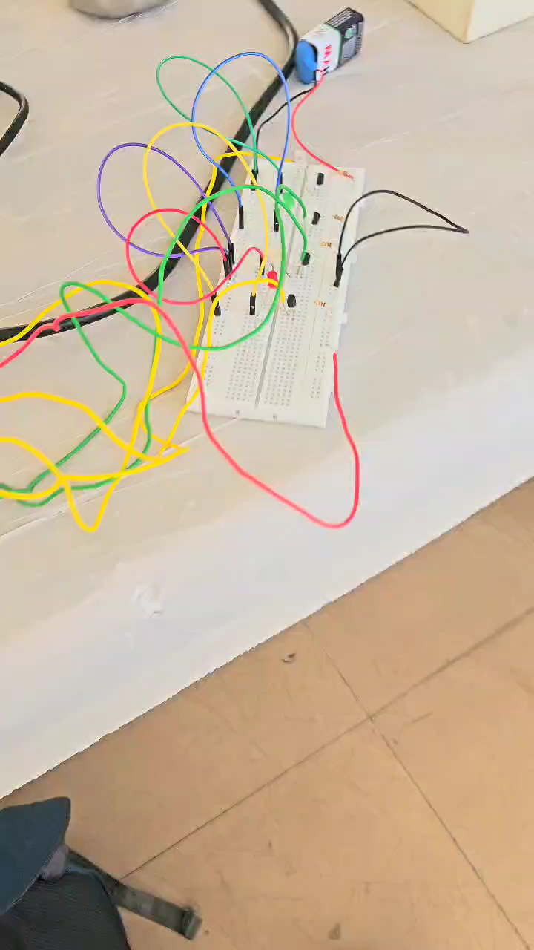
Practical Circuit

Slide 17
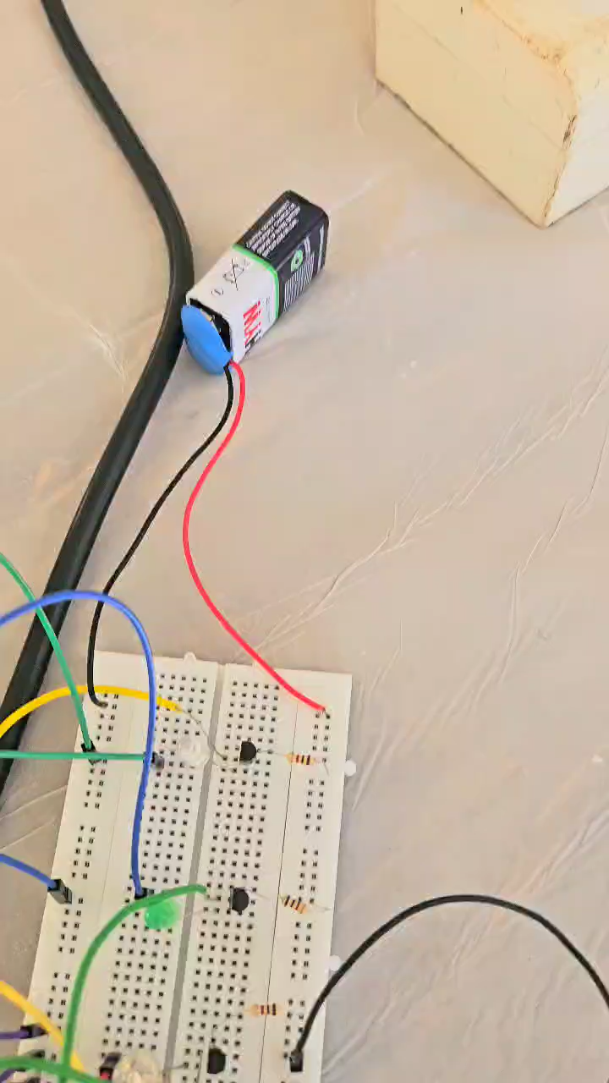
Demonstration

Slide 18
Thank you

